Slide 1
Portfolio Erneuerbare Energien
“Erneuerbare Energien" Hand 11 013
"Erneuerbare Energien” will be released the 16th of June on vinyl, download and stream.. Distribution via Finetunes (Digital, worldwide), Broken Silince (Vinyl, Germany, Austria, Switzerland)."

Slide 2
Background & Overview

Slide 3
Why do we do that?
Personal background
Socio-political background
Obsolete formats: In our opinion formats like popbands or the lonely producer have become boring. These narratives appear to be finished
End point: Dance- and indie/popband-music have arrived at an end point according to our point of view
New, unpleasant situation: There is a new socio-political situation that is not particularly tingling. A conservative, backward-looking social paradigm shift is happening (new right-wing, new backlash, new walls, new heaps of shit)
Missing strategies: Valid counter-drafts are missing
It needs something new! The vacuum must be filled. It needs newly thought music. It needs ecstasy and white noise.

Slide 4
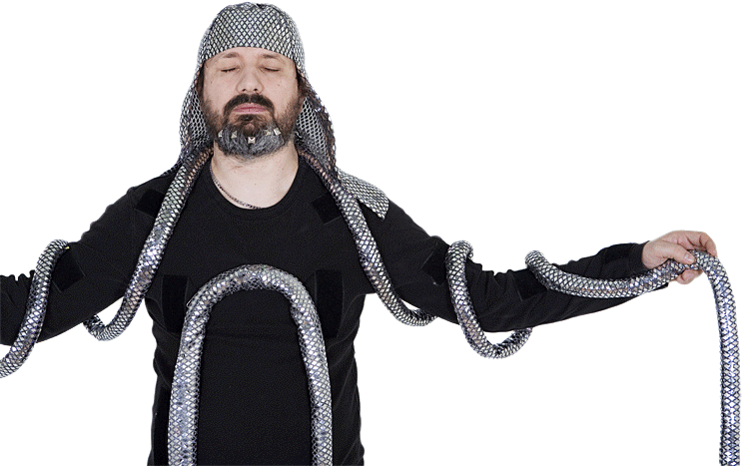
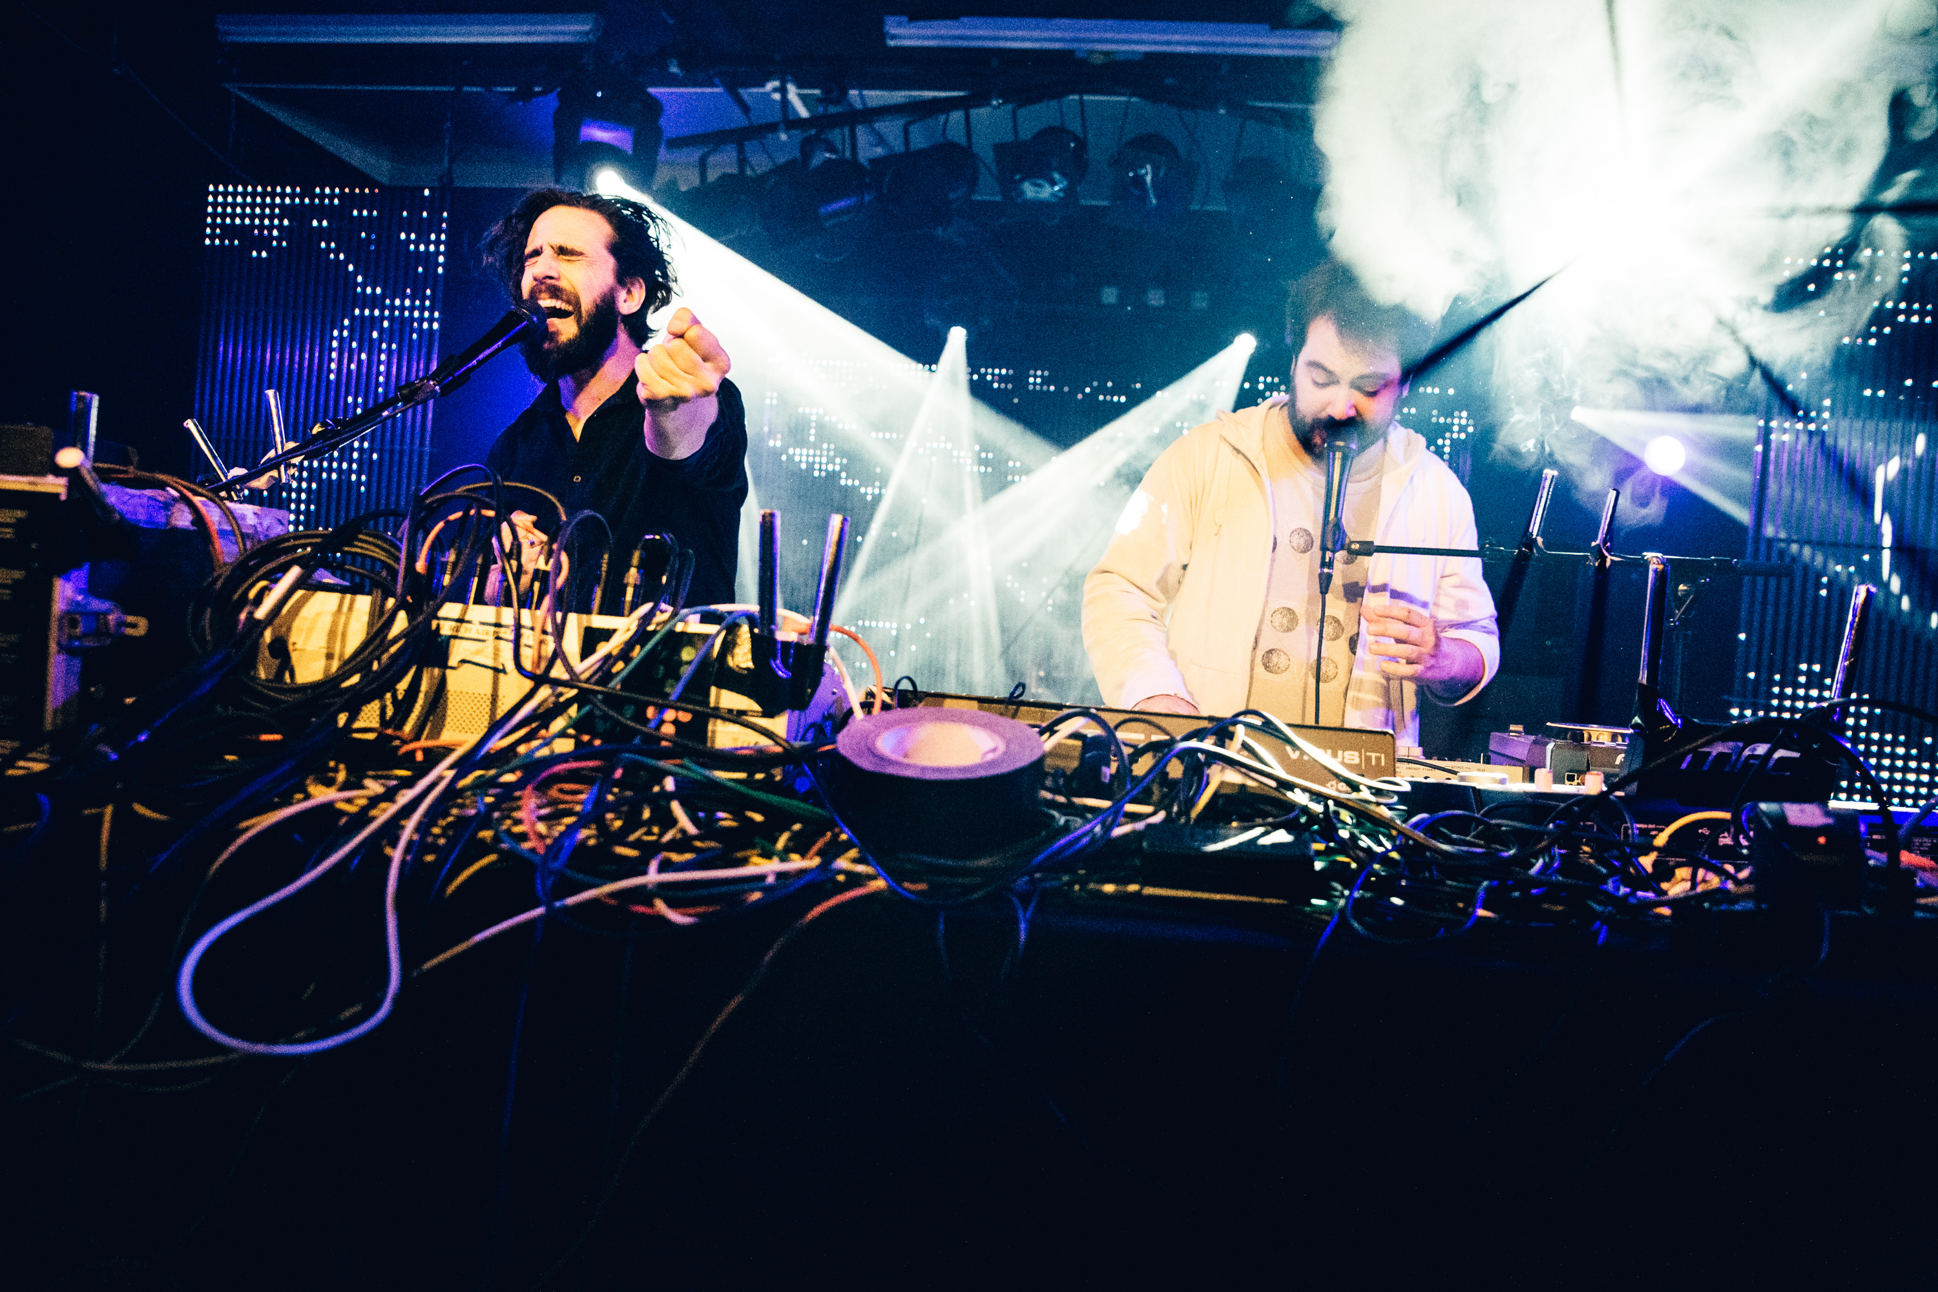
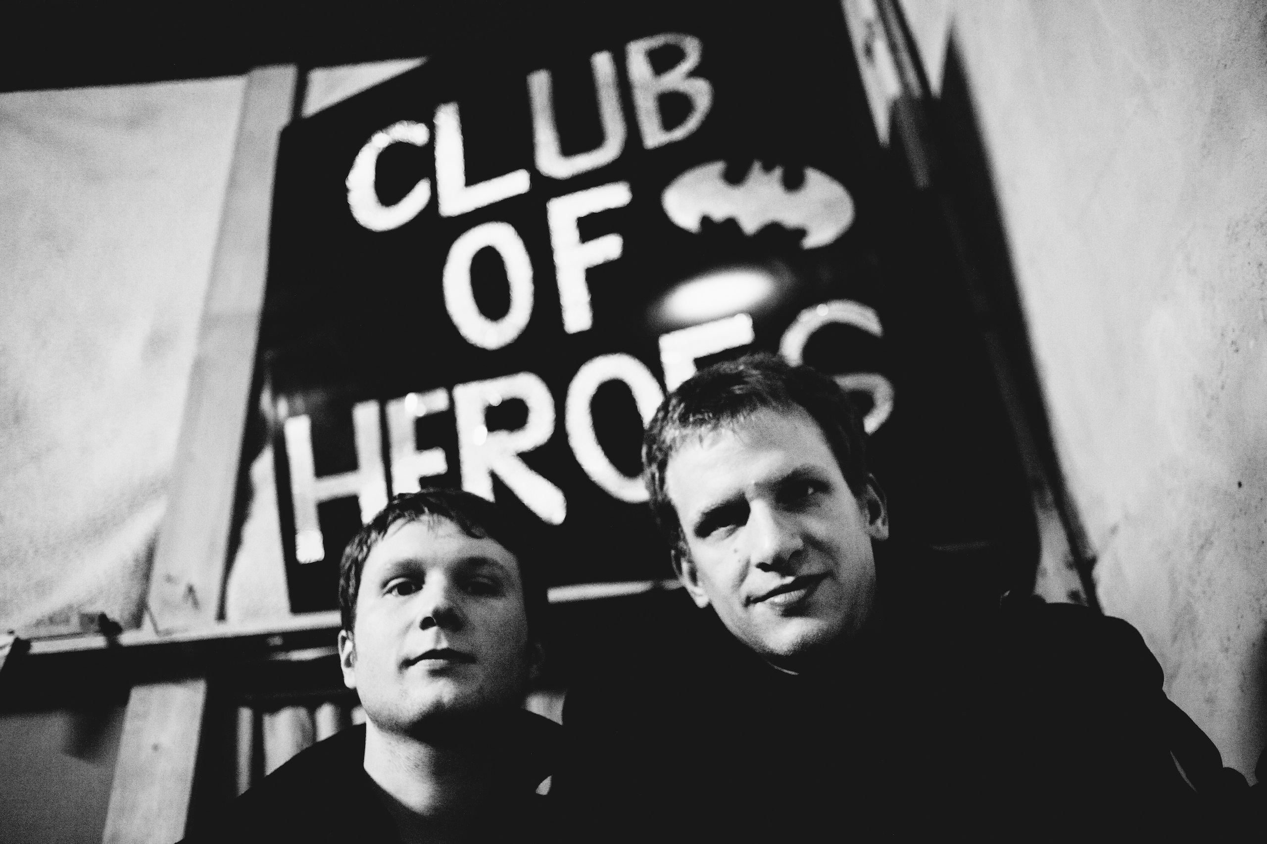
Who are we?
Pascal Fuhlbrügge
Flumroc
Joachim Franz Büchner
Sand 11, Ladomat, Kolossale Jugend, etc
Saalschutz;
Amphibientunnel
Bürgermeister der Nacht; Krautzungen Kollektiv
The role as a DJ / producer is no longer interesting. The corset has become too tight.
Intelligent party service no longer has the same impact and friction. The current architecture has become static and has to be broken and must be changed
The young energetic, popmystic and refiner in search of new possibilities
For these reasons, these three people have joined their project
Erneuerbare Energien – Renewable Energies

Slide 5
Target State-Analysis & Workstreams

Slide 6
What do we want and how do we do it?
Joyful solutions in halfhearted times
Erneuerbare Energien are trying to find a way for a different future. Erneuerbare Energien will be part of the solution and will confront the listener with an utopia that will become reality
Sustainability requires redistribution
Justice in distribution creates space for dreams and adventures.
It needs new approaches and rituals. A changed awareness of individualism and collectives. The music should transform the listener as a self-confident, deciding individual - ready to participate in a new, better reality
Energies flow across borders
Communal Dance-Anthems
Erneuerbare Energien
(Renewable Energies)
The idea of networks is important. Thinking across borders, integration rather than exclusion

Slide 7
And how does it sound?
And indeed...
..unexpecatly, great pop songs are produced. One can still hear the chaos and contradictions of life. Ambivalence, coexisting truths, comedy, abyss and ecstasy. Socially and politically solution-oriented pop songs.
The self-titled album contains structured improvisation. Techniques from club music-production and traditionall band contexts are used as starting points and unfold without a defined goal. You can hear the joy of finding and inventing sounds. Sometimes the tracks orient themselves on the loose live arrangements, sometimes they are condensed to a standard single-length format

Slide 8
Examples of tracks
Am Kanal/ Rasmus hat kein Internet
Wir nüchtern aus
The mantras and verses proclaimed by the characteristic falsetto of Büchner reveal the ambivalent promise of abstinence. Not Marijuana will pacify the world, but a new conscious dealing with resources will bring the mood to a stimulating boiling point
These two tracks describe the loneliness of a young man in a small town (Rasmus hat kein Internet) or the landscape of South Dithmarschen dominated by wind turbines (Am Kanal)
Supermodern Lovesong/
Information, Temperatur, Mobilität
Tesserakt / LED – Licht der Liebe
The two programmatic centerpieces of the album Supermodern Lovesong - a love song to the future – and Information, Temperatur, Mobilität - a hymn to the idea of sustainable technologies as a part of a greater social-political change because, as the text says, "Sustainability demands redistribution" („Nachhaltigkeit verlangt nach Umverteilung“)
Both songs are examples of the band's tendency for unconventional drafts. The listeners are injected with a message of new possibilities in the form of enigmatic earworms

Slide 9
Relevante Statistiken zu Erneuerbare Energien
Name of the band
Origin
Metaphor
Subject
Germany
Switzerland
Level of urbanity
Musical instruments
Drums
Bass
Synth
Vox
Chimes
Guitar

Slide 10
Credits

Slide 11
Credits
Philip
Production
Das Album Erneuerbare Energien wurde von Pascal Fuhlbrügge und Erneuerbare Energien im Sandraum Nord mit Solarstrom produziert
The album Erneuerbare Energien was produced by Pascal Fuhlbrügge and Erneuerbare Energien in the Sandraum Nord with solar power
Video & Artwork
Two of the videos are made in collaboration with Timo Schierhorn (Auge Altona), who has made a name for himself with videos for Deichkind, Die Goldenen Zitronen or Die Vögel and recently created the visuals for Jarvis Cockers and Chilly Gonzales' piece "Room 29"
The Hamburg artist 1010 has designed exclusive artwork for Erneuerbare Energien
Zwei der Videos zur Platte entstehen in Zusammenarbeit mit Timo Schierhorn (Auge Altona), der sich mit Videos für Deichkind, Die Goldenen Zitronen oder Die Vögel einen Namen gemacht hat und zuletzt die Visuals für Jarvis Cockers und Chilly Gonzales' Stück „Room 29“ kreierte.
Der Hamburger Künstler 1010 hat exklusives Artwork für Erneuerbare Energien gestaltet
Contact & Distribution
Stephan Rath stephan@soulsville.de
www.erneuerbareenergien.biz
www.hand11.net
Stephan Rath: stephan@soulsville.de
www.erneuerbareenergien.biz
www.hand11.net
Distribution via Finetunes (digital, worldwide), Broken Silince (Vinyl, Germany, Austria, Switzerland)

